Slide 1
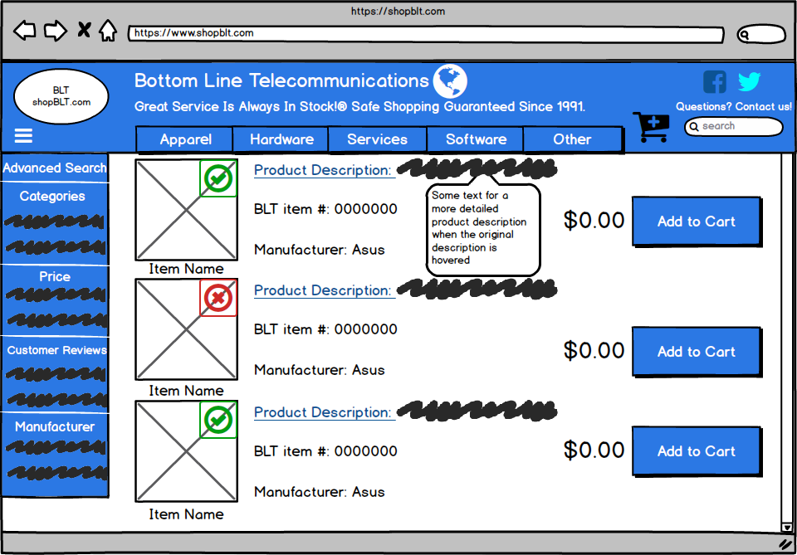
Team shopBLT: Alonso, Matthew, Juwan, JT, and Philip
Mockup Context: Product Listings page that is presented after a user initiates a search.

Slide 2
Product Listings Re-design for shopBLT
Problem: Users had difficulty parsing the information presented in the old product listings format (table). Information that was directly related to the customer was overshadowed by irrelevant logistical information. Product visibility in the form of images did not have an optimized implementation. Clear signifiers were not readily present to the user nor were they properly utilized to streamline communication between the site and the user.
What we changed: We changed the table format to a linear assortment of products. We added a product image to be displayed indefinitely to the user. In the top right hand corner of the image there is a signifier (red X, or green check-mark) to indicate whether an item is in stock or not. Retained important information such as product description/name, item number, manufacturer, and price. We also included a tooltip to extend the product description to reduce the amount of backtracking the customer had to do in order to find product information.
Did we fix it?: We believe these changes improve product visibility and provide a more streamlined method of communicating product information, by reducing the amount of cluttering information, reformatting important information, and signifying trivial information.

